Slide 1

Development of machine learning models to process Electronic Health Records – Explainable Models
Week 14 Meeting, 24/1/2021

Slide 2
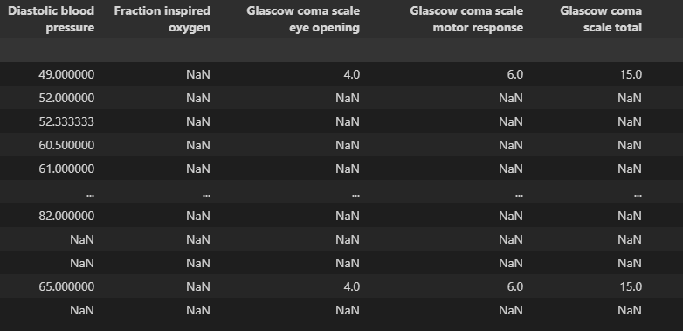
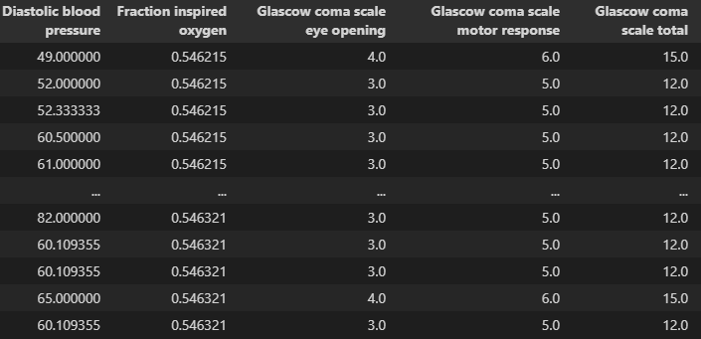

MICE algorithm
Step 1: Impute all missing values using mean imputation (and use this as the baseline)

Slide 3
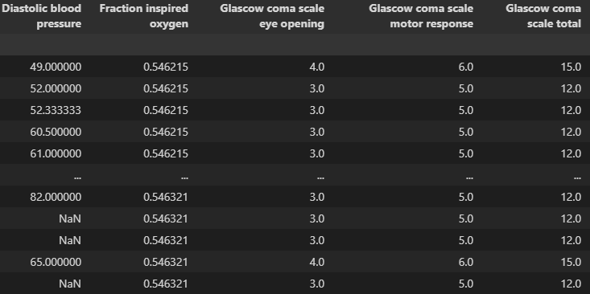



MICE algorithm
Step 2: Replace the column with the original data (with missing values), use this column as label, and all other columns with
Step 3: Predict the missing value using linear regression, repeat this for every column.

Slide 4
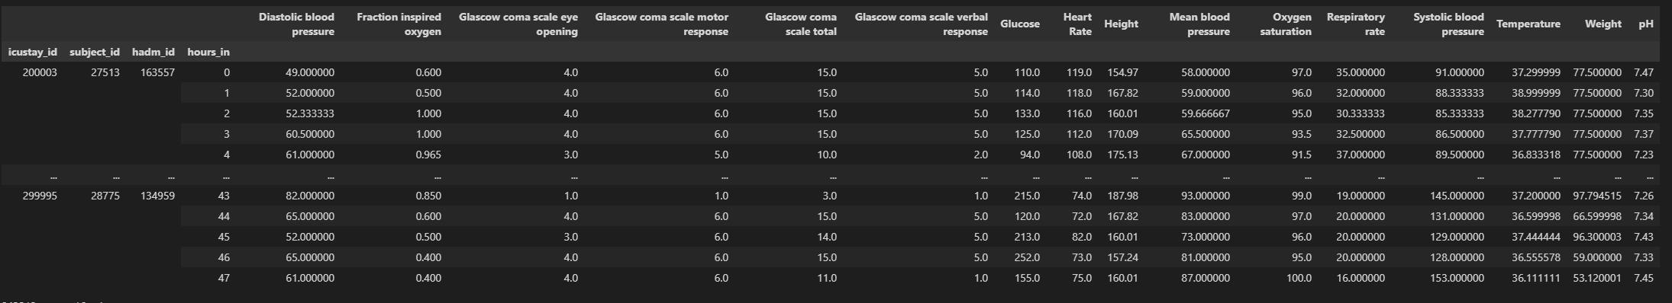
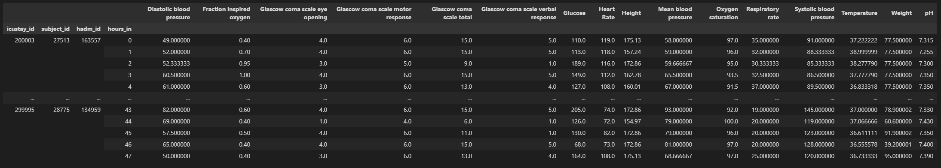
MICE algorithm
Step 4: Replace the baseline with the new data, repeat step 2-3 for multiple iterations

Slide 5
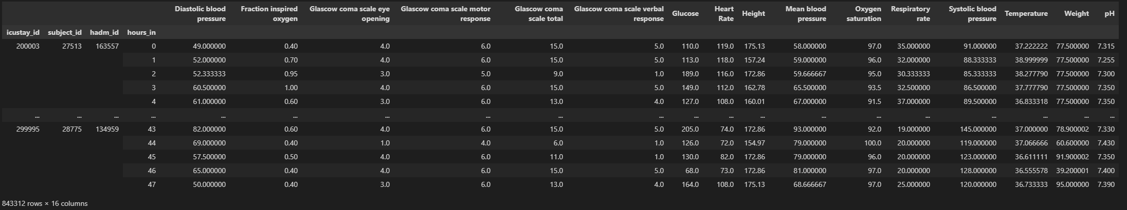
Problems with the algorithm
Height obviously should only have 1 same value instead of different value for each patient

Slide 6
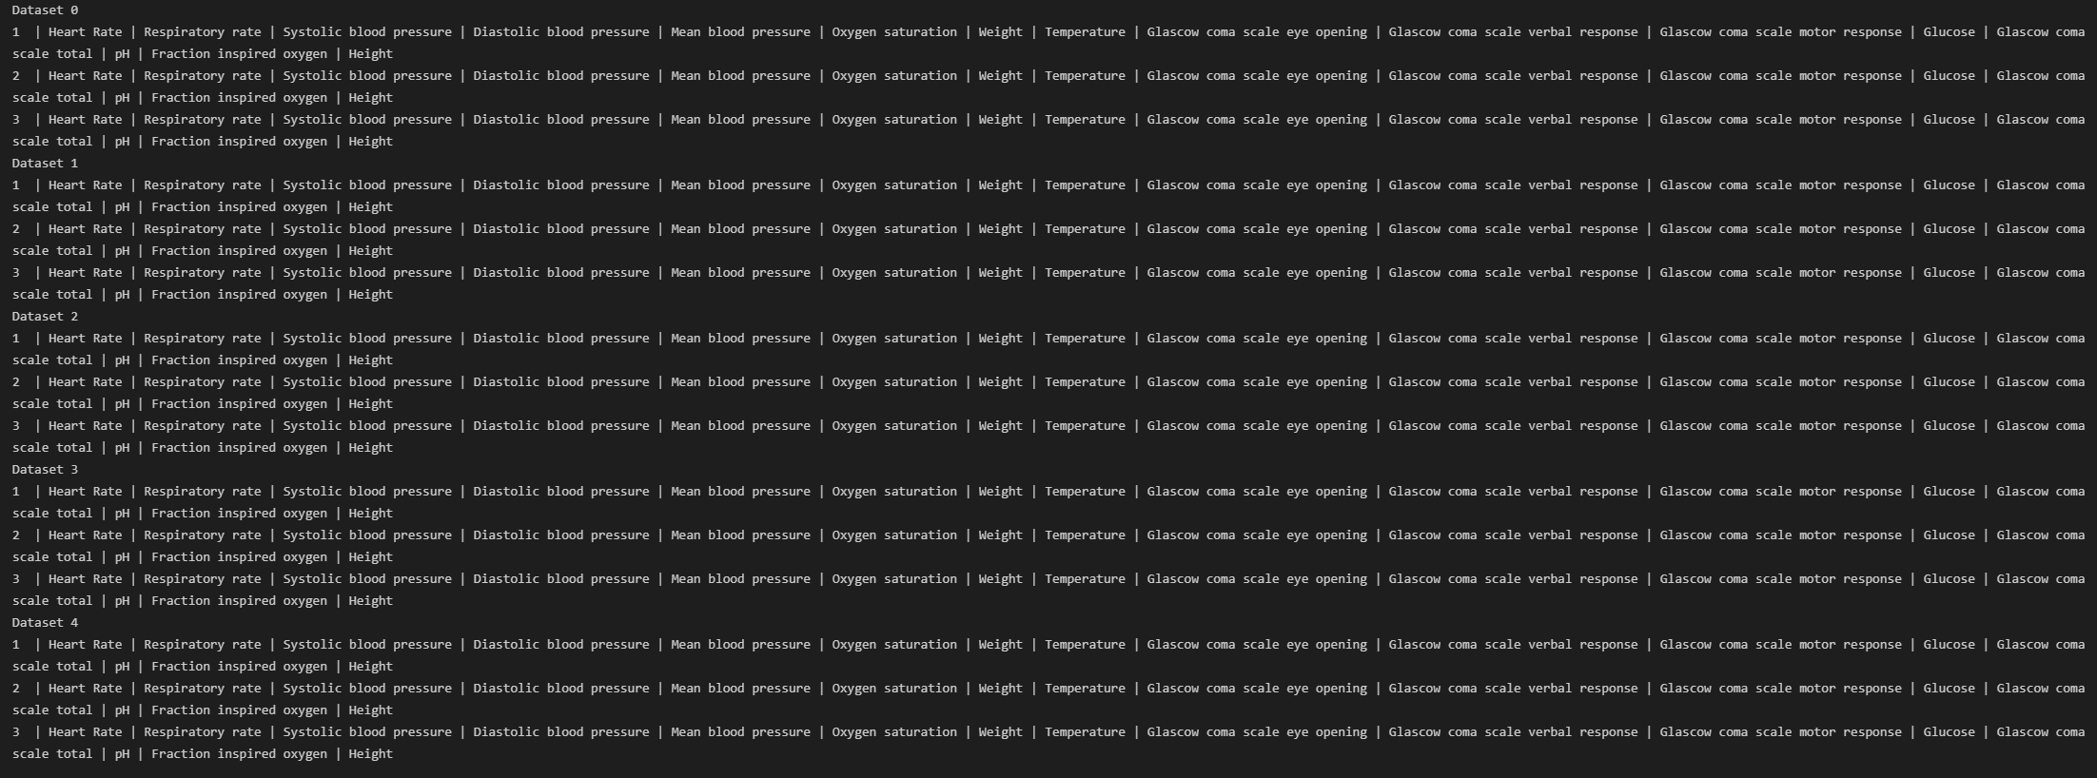

Slide 7
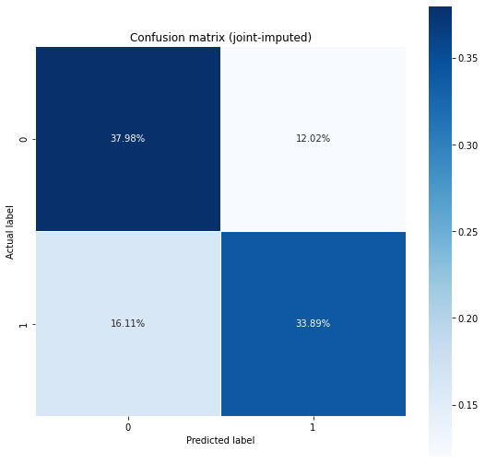
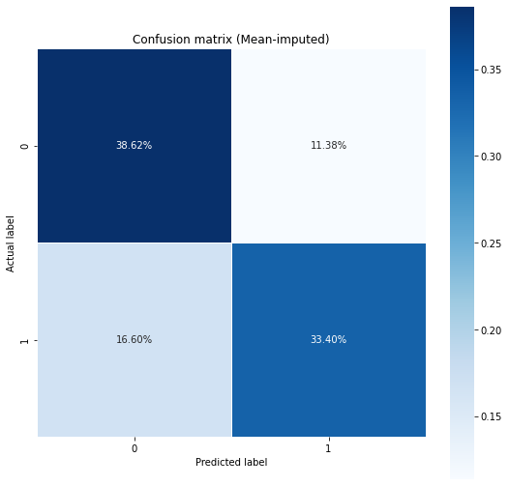
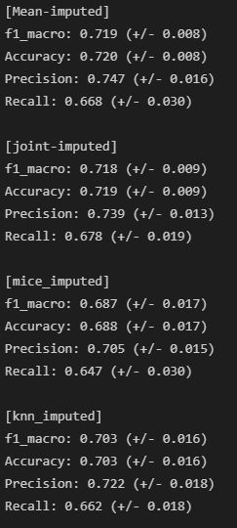
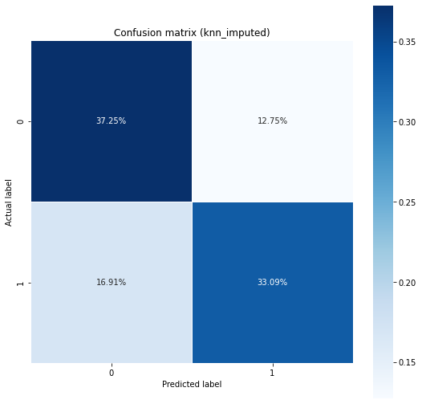

Performance comparison (Logistic Regression)

Slide 8
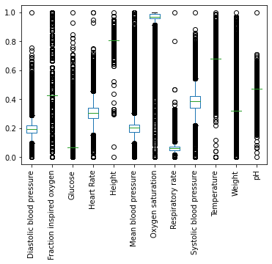
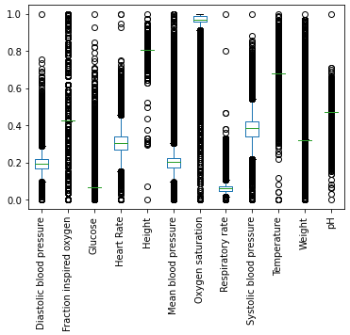
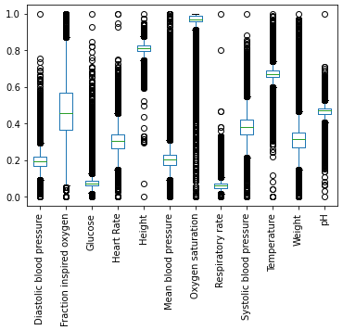
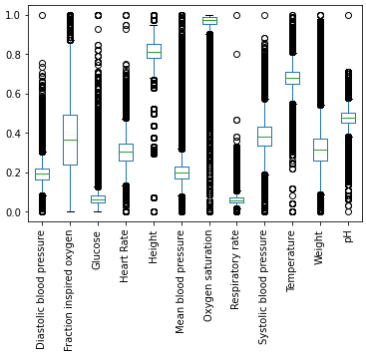
Distributions
Mean imputed
Joint imputed
Knn imputed
MICE imputed

Slide 9
Correlations
Missing at random
Missing not at random

Slide 10
https://www.numpyninja.com/post/mice-algorithm-to-impute-missing-values-in-a-dataset

